Slide 1
Data Modeling Using ER Diagrams
CSC311A - Database Systems
B. Tech. 2014
Course Leader:
Gp Cpt N. Rath VSM
Ami Rai E.

Slide 2
Objectives
At the end of this lecture, student will be able to
explain ER modelling
explain entities and attributes used in ER diagrams
explain the relationships used in ER diagrams

Slide 3
Topics
ER Model Concepts
Entities
Attributes
Relationships

Slide 4
ER Modelling
Entity-Relationship (ER) model, is a popular high-level conceptual data model
This model and its variations are frequently used for the conceptual design of database applications, and many database design tools employ its concepts
The diagrammatic notation associated with the ER model, is known as ER diagrams

Slide 5
Entities
Entities are specific objects or things in the mini-world that are represented in the database
E.g., the EMPLOYEE John Smith, the Research DEPARTMENT, the ProductX PROJECT
Entities with the same basic attributes are grouped or typed into an entity type
For example, the entity type EMPLOYEE and PROJECT

Slide 6
Attributes
Attributes are properties used to describe an entity
E.g., an EMPLOYEE entity type may have the attributes Name, SSN, Address, Sex, BirthDate, etc.
Each attribute has a value set (or data type) associated with it
E.g. integer, string, subrange, enumerated type, …
A specific entity will have a value for each of its attributes
E.g., a specific employee entity may have Name='John Smith', SSN='123456789', Address ='731, Fondren, Houston, TX', Sex='M', BirthDate='09-JAN-55‘

Slide 7
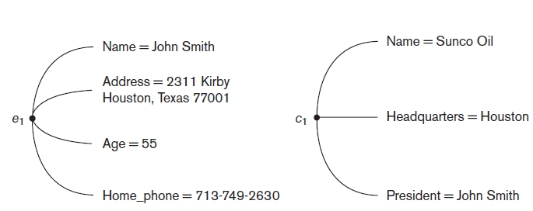
Entities and Attributes - Example
Two entities, EMPLOYEE e1, and COMPANY c1, and their attributes

Slide 8
Types of Attributes
Simple
Each entity has a single atomic value for the attribute
E.g., SSN or Sex
Composite
The attribute may be composed of several components
E.g.,
Address (Apt#, House#, Street, City, State, ZipCode, Country)
Name (FirstName, MiddleName, LastName)
Composition may form a hierarchy where some components are themselves composite
Multi-valued
An entity may have multiple values for that attribute
E.g., Color of a CAR or PreviousDegrees of a STUDENT
Denoted as {Color} or {PreviousDegrees}

Slide 9
Composite and Multivalued Attributes
In general, composite and multi-valued attributes may be nested arbitrarily to any number of levels, although this is rare
E.g., PreviousDegrees of a STUDENT is a composite multi-valued attribute denoted by {PreviousDegrees (College, Year, Degree, Field)}
Multiple PreviousDegrees values can exist
Each has four subcomponent attributes:
College, Year, Degree, Field

Slide 10
Key Attributes
An attribute of an entity type for which each entity must have a unique value is called a key attribute of the entity type
E.g., SSN of EMPLOYEE
A key attribute may be composite
E.g., VehicleTagNumber is a key of the CAR entity type with components (Number, State)
An entity type may have more than one key
The CAR entity type may have two keys
VehicleIdentificationNumber (popularly called VIN)
VehicleTagNumber (Number, State), aka license plate number
Each key is underlined

Slide 11
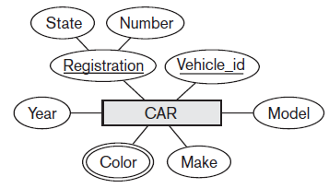
Displaying an Entity type and Attributes
An entity type is displayed in a rectangular box
Attributes are displayed in ovals
Each attribute is connected to its entity type
Components of a composite attribute are connected to the oval representing the composite attribute
Each key attribute is underlined
Multivalued attributes displayed in double ovals

Slide 12
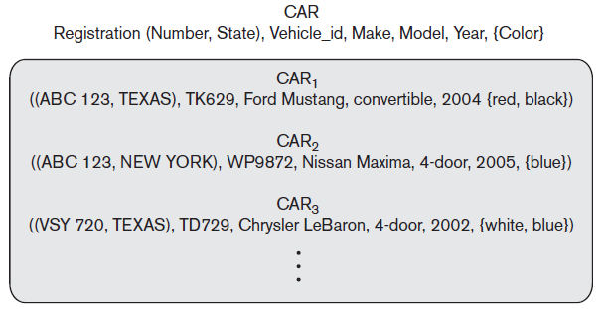
Entity Set
Each entity type will have a collection of entities stored in the database
called the entity set
Entity set is the current state of the entities of that type that are stored in the database
Three CAR entity instances
in the entity set for CAR
Same name (CAR) used to refer to
both the entity type and the entity
set

Slide 13
Initial Design of Entity Types for the COMPANY Database Schema
Based on the requirements, we can identify four initial entity types in the COMPANY database:
DEPARTMENT
PROJECT
EMPLOYEE
DEPENDENT
Their initial design is shown on the following slide
The initial attributes shown are derived from the requirements description

Slide 14
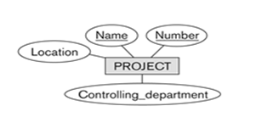

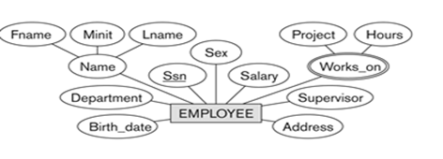
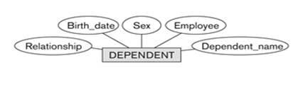
Initial Design of Entity Types EMPLOYEE, DEPARTMENT, PROJECT, DEPENDENT

Slide 15
Relationships and Relationship Types
A relationship relates two or more distinct entities with a specific meaning
For example, EMPLOYEE John Smith WORKS_ON the ProductX PROJECT, or EMPLOYEE Franklin Wong MANAGES the Research DEPARTMENT
Relationships of the same type are grouped or typed into a relationship type
For example
the WORKS_ON relationship type in which EMPLOYEEs and PROJECTs participate
the MANAGES relationship type in which EMPLOYEEs and DEPARTMENTs participate
The degree of a relationship type is the number of participating entity types
Both MANAGES and WORKS_ON are binary relationships

Slide 16
Refining The COMPANY Database Schema By Introducing Relationships
By examining the requirements, six relationship types are identified
All are binary relationships( degree 2)
Listed below with their participating entity types:
WORKS_FOR (between EMPLOYEE, DEPARTMENT)
MANAGES (also between EMPLOYEE, DEPARTMENT)
CONTROLS (between DEPARTMENT, PROJECT)
WORKS_ON (between EMPLOYEE, PROJECT)
SUPERVISION (between EMPLOYEE (as subordinate), EMPLOYEE (as supervisor))
DEPENDENTS_OF (between EMPLOYEE, DEPENDENT)

Slide 17
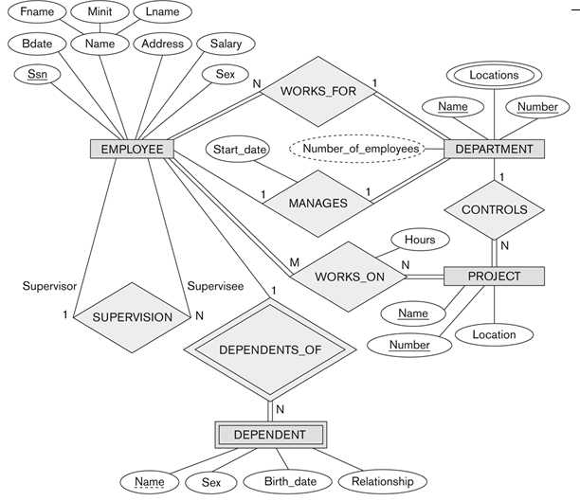
ER DIAGRAM – Relationship Types

Slide 18
Discussion on Relationship Types
In the refined design, some attributes from the initial entity types are refined into relationships:
Manager of DEPARTMENT -> MANAGES
Works_on of EMPLOYEE -> WORKS_ON
Department of EMPLOYEE -> WORKS_FOR
etc
In general, more than one relationship type can exist between the same participating entity types
MANAGES and WORKS_FOR are distinct relationship types between EMPLOYEE and DEPARTMENT
Different meanings and different relationship instances

Slide 19
Recursive Relationship Type
In some cases the same entity type participates more than once in a relationship type in different roles
Example: the SUPERVISION relationship
EMPLOYEE participates twice in two distinct roles
supervisor (or boss) role
supervisee (or subordinate) role
Each relationship instance relates two distinct EMPLOYEE entities
One employee in supervisor role
One employee in supervisee role

Slide 20
Weak Entity Types
An entity that does not have a key attribute
Weak entities are identified by the combination of:
A partial key of the weak entity type
The particular entity they are related to in the identifying entity type
Example:
DEPENDENT is a weak entity type
A DEPENDENT entity is identified by the dependent’s first name, and the specific EMPLOYEE with whom the dependent is related
Name of DEPENDENT is the partial key
EMPLOYEE is its identifying entity type via the identifying relationship type DEPENDENT_OF

Slide 21
Constraints on Relationships
There are two types of constraints on relationships
Cardinality ratio (specifies maximum participation)
Existence Dependency Constraint or Participation constraint (specifies minimum participation)

Slide 22
Cardinality Ratio
Cardinality Ratio (specifies maximum participation)
One-to-one (1:1)
One-to-many (1:N) or Many-to-one (N:1)
Many-to-many (M:N)
Cardinality ratio (of a binary relationship) is shown by placing appropriate numbers on the relationship edges

Slide 23
Participation Constraint
Specifies whether the existence of an entity depends on its being related to another entity via the relationship type
Two types of participation constraints
Total
one or more (mandatory participation, existence-dependent)
E.g., If a company policy states that every employee must work for a department, then an employee entity can exist only if it participates in at least one WORKS_FOR relationship instance
Shown by double line

Slide 24
Participation Constraint contd.
Partial
zero (optional participation, not existence-dependent)
E.g., Not to expect every employee to manage a department meaning that some or part of the set of employee entities are related to some department entity via MANAGES, but not necessarily all
Shown by single lines

Slide 25
Attributes of Relationship Types
A relationship type can have attributes:
For example, Hours of WORKS_ON
Its value for each relationship instance describes the number of hours per week that an EMPLOYEE works on a PROJECT
A value of Hours depends on a particular (employee, project) combination
Most relationship attributes are used with M:N relationships
In 1:N relationships, they can be transferred to the entity type on the N-side of the relationship

Slide 26
Alternative (Min, Max) Notation For Relationship Structural Constraints
Specified on each participation of an entity type E in a relationship type R
Specifies that each entity e in E participates in at least min and at most max relationship instances in R
Default(no constraint): min=0, max=n (signifying no limit)
Must have min≤max, min≥0, max ≥1
Derived from the knowledge of mini-world constraints

Slide 27
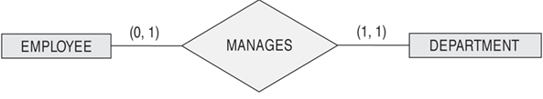

The (Min,max) Notation For Relationship Constraints
Example:
A department has exactly one manager and an employee can manage at most one department
Specify (1,1) for participation of DEPARTMENT in MANAGES
Specify (0,1) for participation of EMPLOYEE in MANAGES
Read the min,max numbers next to the entity type and looking away from the entity type

Slide 28
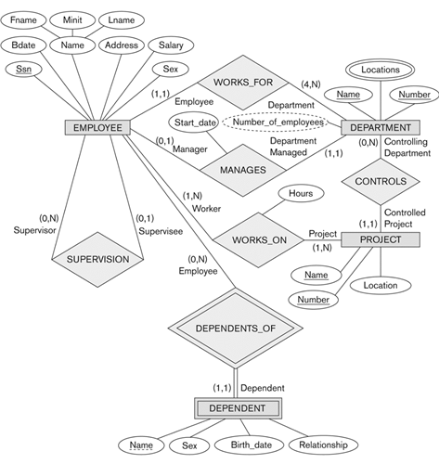
COMPANY ER Schema Diagram Using (Min, Max)

Slide 29
Relationships of Higher Degree
Relationship types of degree 2 are called binary
Relationship types of degree 3 are called ternary and of degree n are called n-ary
In general, an n-ary relationship is not equivalent to n binary relationships
Constraints are harder to specify for higher-degree relationships (n > 2) than for binary relationships

Slide 30
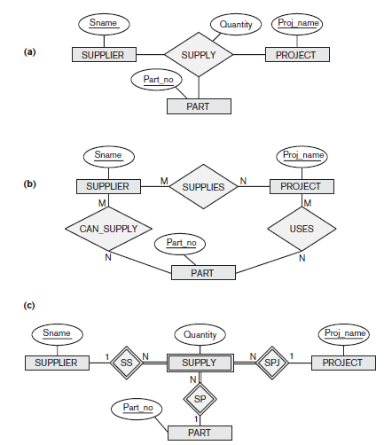
Example of A Ternary Relationship

Slide 31
Summary
The modeling concepts of a high-level conceptual data model can be presented using the Entity-Relationship (ER) model
The ER model consists of entities, their attributes and the relationship between them
Different types of attributes are
Simple
Composite
Multivalued
There are two methods for specifying the structural constraints on relationship types
Cardinality ratios (1:1, 1:N, M:N for binary relationships)
Participation constraints (total, partial)

